Slide 1
Gaussian Elimination

Slide 2
System of Linear Equation
-3x₁ + 2x₂ – x₃ = -1
6x₁ - 6x₂ + 7x₃ = -7
3x₁ - 4x₂ + 4x₃ = -6

Slide 3
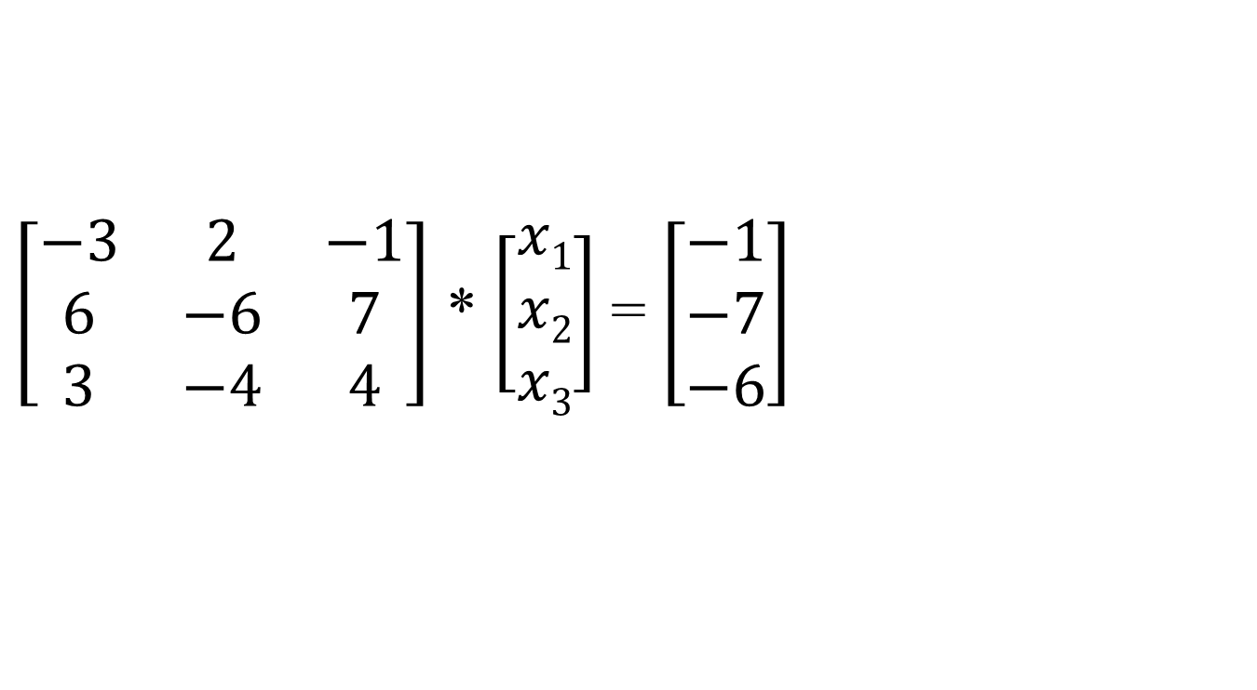
Ax = b
$\left[\begin{matrix}−3 & 2 & −1 \\ 6 & −6 & 7 \\ 3 & −4 & 4\end{matrix}\right]$ * $\left[\begin{matrix}x1 \\ x2 \\ x3\end{matrix}\right]$ = $\left[\begin{matrix}−1 \\ −7 \\ −6\end{matrix}\right]$

Slide 4
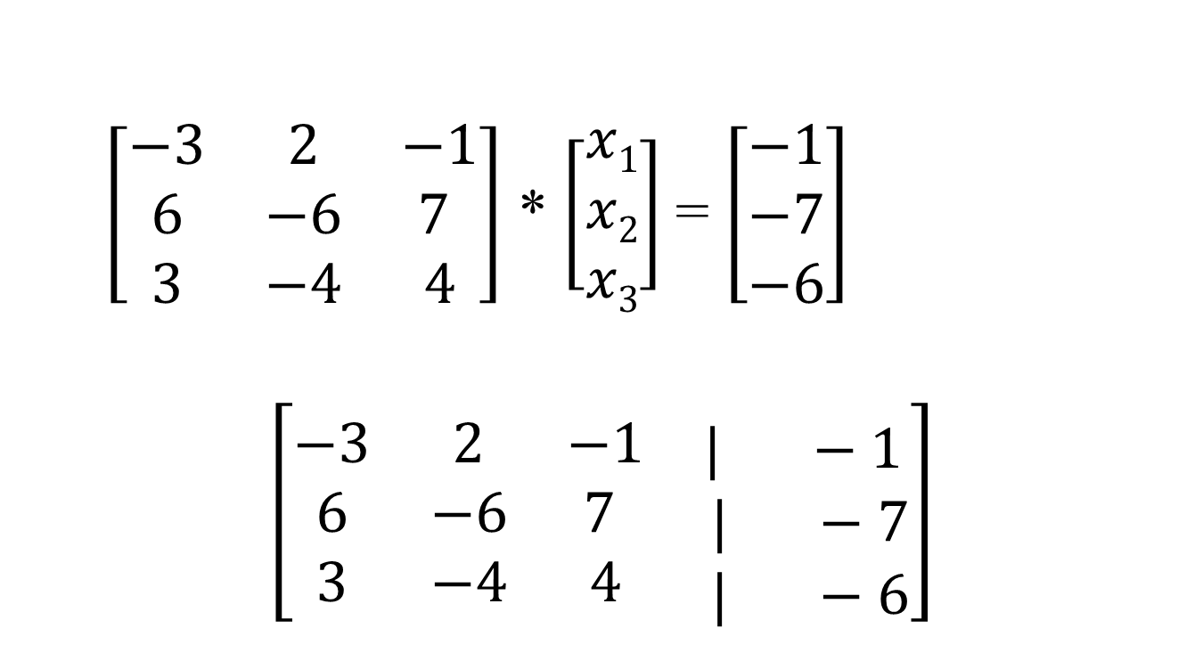
Augmented Matrix
$\left[\begin{matrix}−3 & 2 & −1 \\ 6 & −6 & 7 \\ 3 & −4 & 4\end{matrix}\right]$ * $\left[\begin{matrix}x1 \\ x2 \\ x3\end{matrix}\right]$ = $\left[\begin{matrix}−1 \\ −7 \\ −6\end{matrix}\right]$
$$\left[\begin{matrix}−3 & 2 & −1 \\ 6 & −6 & 7 \\ 3 & −4 & 4\end{matrix}\begin{matrix}\begin{aligned} \\ | −1\end{aligned} \\ | −7 \\ | −6\end{matrix}\right]$$

Slide 5
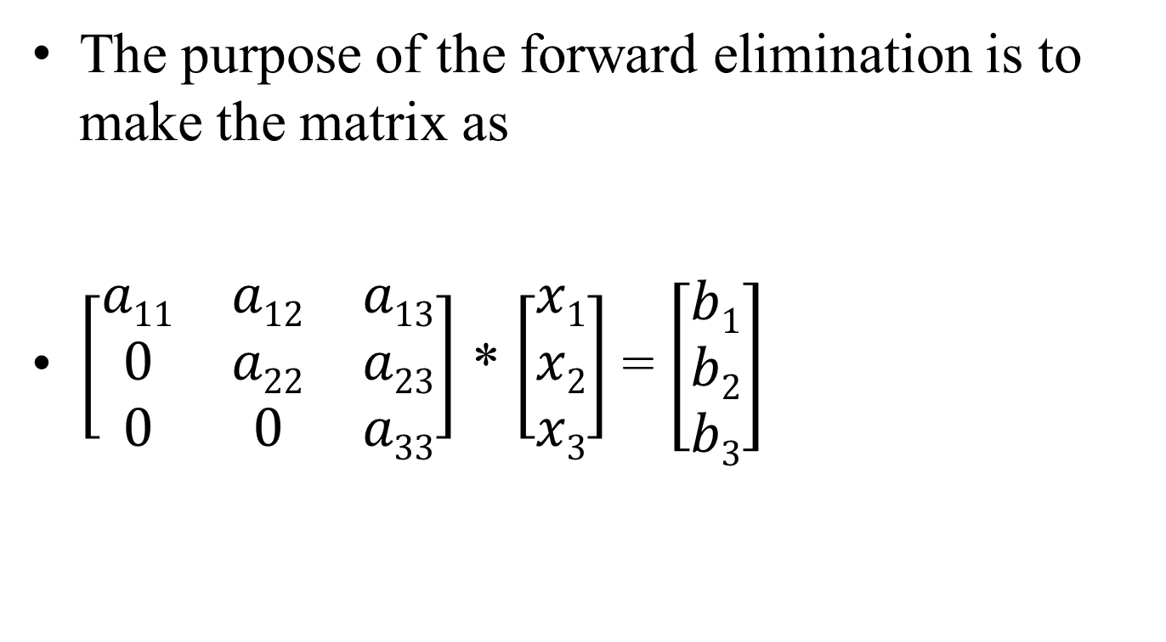
Forward Elimination
The purpose of the forward elimination is to make the matrix as
$\left[\begin{matrix}a11 & a12 & a13 \\ 0 & a22 & a23 \\ 0 & 0 & a33\end{matrix}\right]$ * $\left[\begin{matrix}x1 \\ x2 \\ x3\end{matrix}\right]$ = $\left[\begin{matrix}b1 \\ b2 \\ b3\end{matrix}\right]$

Slide 6
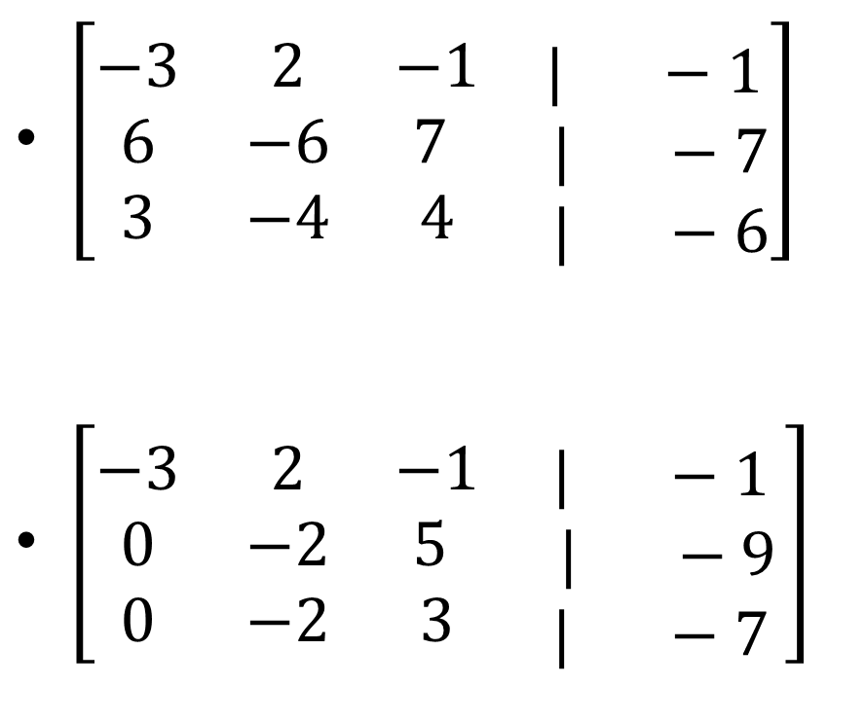
$\left[\begin{matrix}−3 & 2 & −1 \\ 6 & −6 & 7 \\ 3 & −4 & 4\end{matrix}\begin{matrix}\begin{aligned} \\ | −1\end{aligned} \\ | −7 \\ | −6\end{matrix}\right]$
$\left[\begin{matrix}−3 & 2 & −1 \\ 0 & −2 & 5 \\ 0 & −2 & 3\end{matrix}\begin{matrix}\begin{aligned} \\ | −1\end{aligned} \\ | −9 \\ | −7 \end{matrix}\right]$
< == R₂ + 2R₁
< == R₃ + R₁

Slide 7
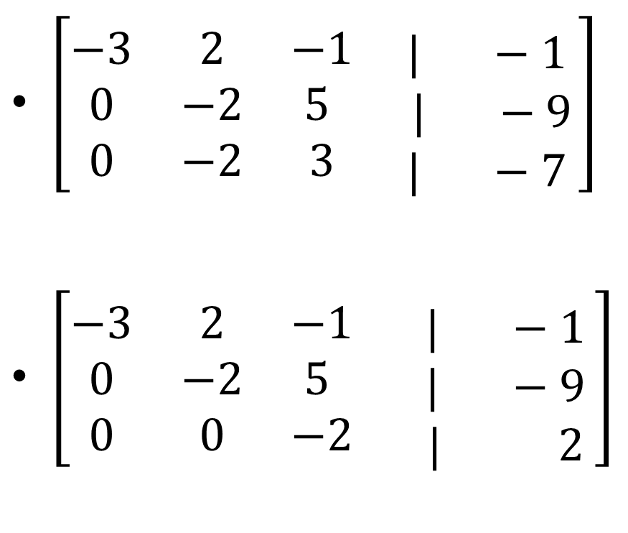
$\left[\begin{matrix}−3 & 2 & −1 \\ 0 & −2 & 5 \\ 0 & −2 & 3\end{matrix}\begin{matrix}\begin{aligned} \\ | −1\end{aligned} \\ | −9 \\ | −7 \end{matrix}\right]$
$\left[\begin{matrix}−3 & 2 & −1 \\ 0 & −2 & 5 \\ 0 & 0 & −2\end{matrix}\begin{matrix}\begin{aligned} \\ | −1\end{aligned} \\ | −9 \\ | 2 \end{matrix}\right]$
< == R₃ – R₂

Slide 8
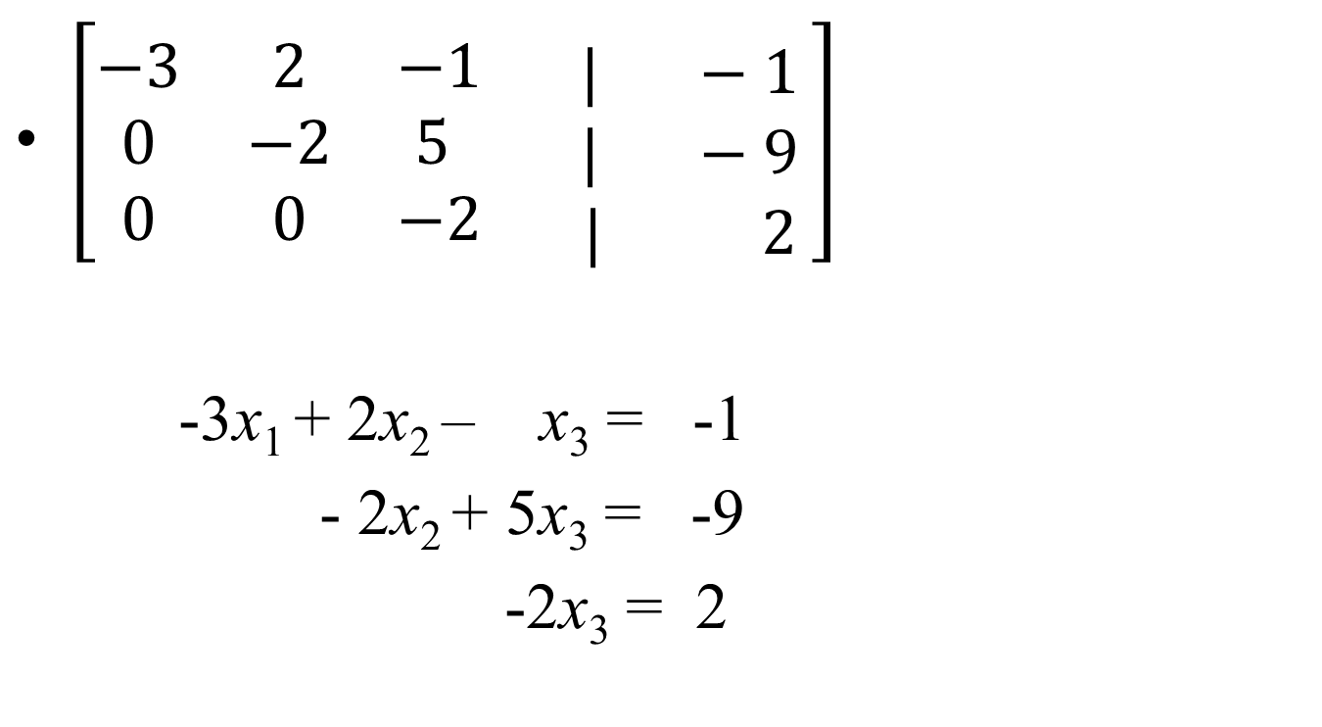
Equations looks like
$\left[\begin{matrix}−3 & 2 & −1 \\ 0 & −2 & 5 \\ 0 & 0 & −2\end{matrix}\begin{matrix}\begin{aligned} \\ | −1\end{aligned} \\ | −9 \\ | 2 \end{matrix}\right]$
-3x₁ + 2x₂ – x₃ = -1
- 2x₂ + 5x₃ = -9
-2x₃ = 2

Slide 9
Backward Substitution
-3x₁ + 2x₂ – x₃ = -1
- 2x₂ + 5x₃ = -9
-2x₃ = 2
x₃ = -1
x₂ = (1/(-2)) * (-9 - 5x₃) = 2
x₁ ₌ (1/(-3))*(-1 - 2x₂ + x₃) = 2

Slide 10
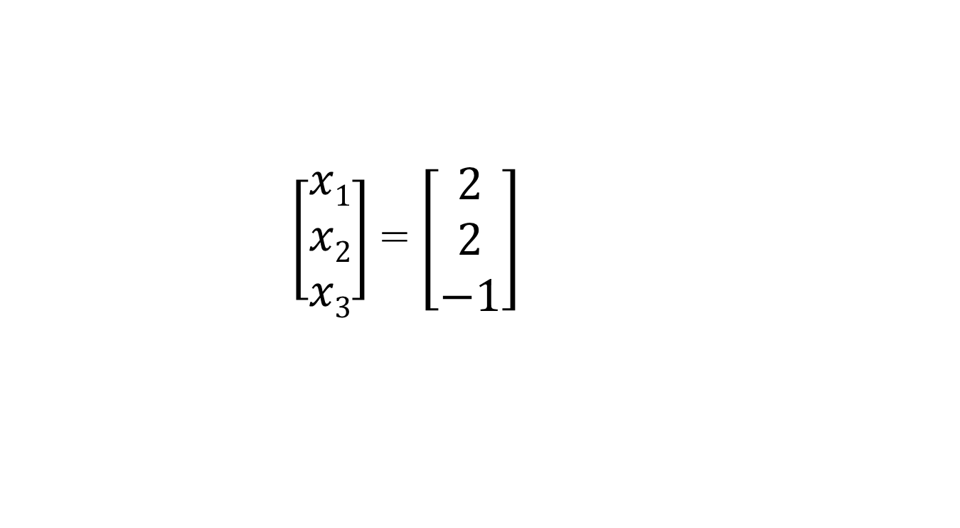
Solution
$\left[\begin{matrix}x1 \\ x2 \\ x3\end{matrix}\right]$ = $\left[\begin{matrix}2 \\ 2 \\ −1\end{matrix}\right]$

Slide 11
https://www.youtube.com/watch?v=_QcKbZUtWYA

Slide 12
Exercise
Write a Java program to implement the Gaussian Elimination method to solve a matrix equation

